Slide 1
Changes in lectures
22.04.2019 (No Lecture) -> Move to the next week
06.05.2019 (No lecture) -> Move to the next week

Slide 2
Must know Android libraries

Slide 3
Why to use external library in App?

Slide 4

Speed up development process

Slide 5
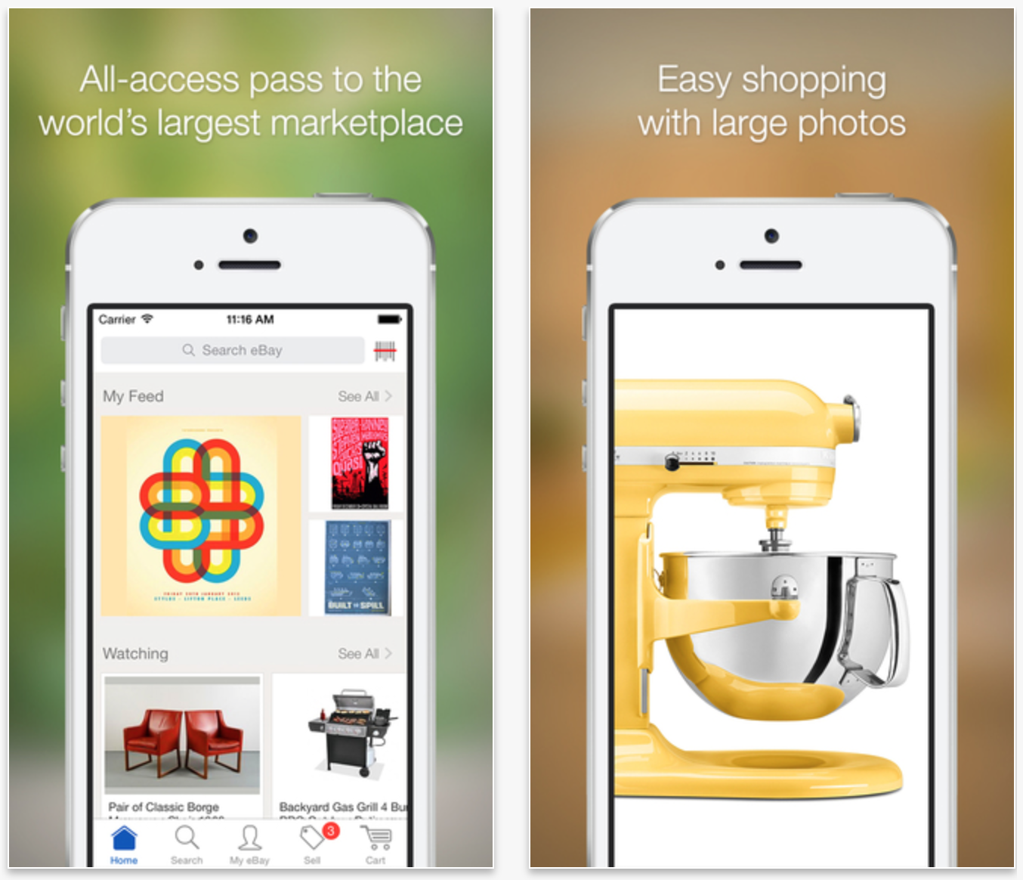
Allows to focus only on your app core functionality

Slide 6
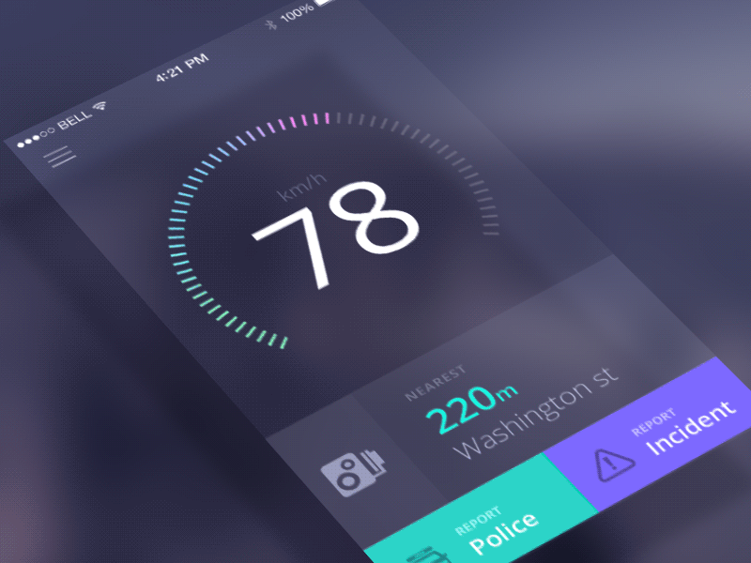
Allows to use fancy stuff (Animations, view decorations, etc)

Slide 7

Secure your app if you use industry standard libraries

Slide 8
Downside of using external library

Slide 9
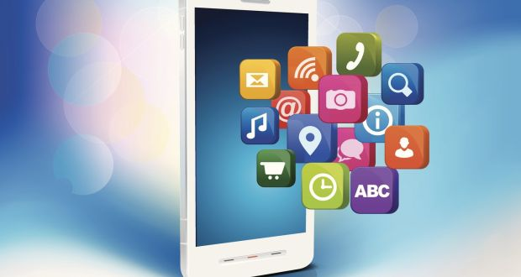
In some cases you are not in control of library code
Cant be modified in a way you need it
Cant be bugfixed by you

Slide 10

May contains intended backdoors

Slide 11

May cost quite a lot

Slide 12
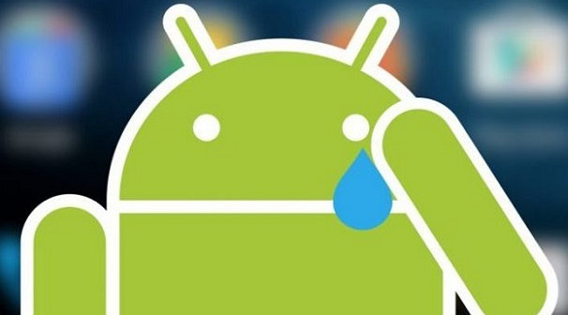
May be changed/removed/become paid at any time without notice

Slide 13
Library Types
.aar – Java Library with Android stuff inside
.jar – standard Java library

Slide 14
Library-SDK-Framework

Slide 15

Library
A Library is a chunk of code that you can call from your own code, to help you do things more quickly/easily. For example, a Bitmap Processing library will provide facilities for loading and manipulating bitmap images, saving you having to write all that code for yourself. Typically a library will only offer one area of functionality (processing images or operating on zip files)

Slide 16

SDK
An SDK (software development kit) is a library or group of libraries (often with extra tool applications, data files and sample code) that aid you in developing code that uses a particular system. For example you would like to give your users ability to sync files from your app with their dropbox. You could use Dropbox SDK in order to handle user login to dropbox, uploading/downloading files and keeping them up to date. An SDK will still usually have a single focus.

Slide 17

framework
A framework is a big library or group of libraries that provides many services (rather than perhaps only one focussed ability as most libraries/SDKs do). For example, .NET provides an application framework - it makes it easier to use most (if not all) of the disparate services you need (e.g. Windows, graphics, printing, communications, etc) to write a vast range of applications - so one "library" provides support for pretty much everything you need to do. Often a framework supplies a complete base on which you build your own code, rather than you building an application that consumes library code to do parts of its work.

Slide 18
Standard pack

Slide 19
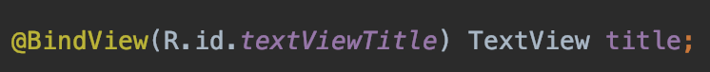

Slide 20
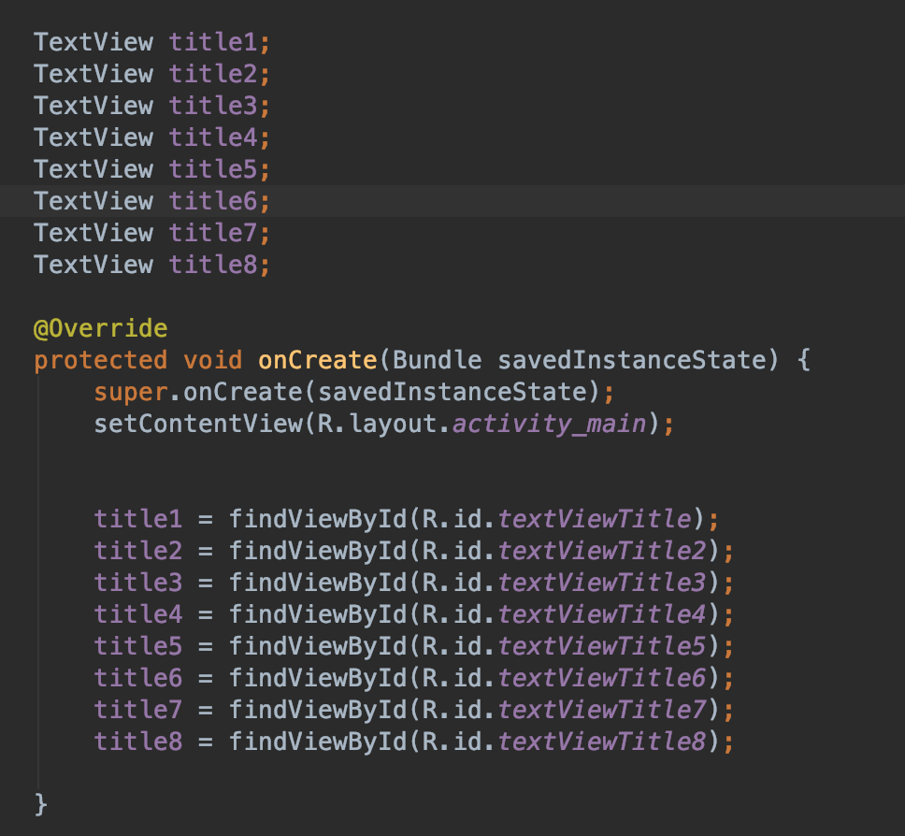

Slide 21
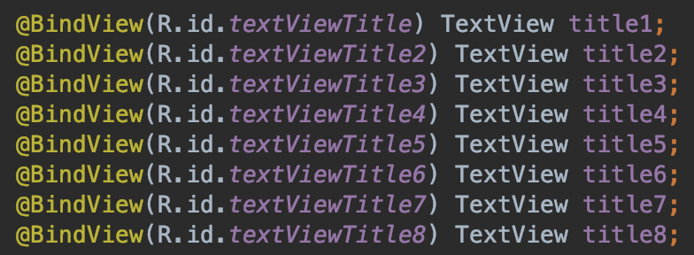

Slide 22
Butterknife (Code generation)
Butterknife is a popular View "injection" library for Android. This means that the library writes common boilerplate view code for you based on annotations to save you time and significantly reduce the lines of boilerplate code written.
http://jakewharton.github.io/butterknife/

Slide 23
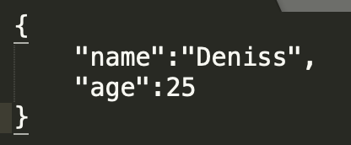
Coming from server

Slide 24
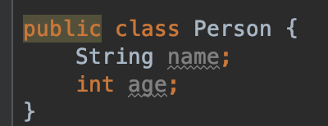
Create the same structured Class

Slide 25
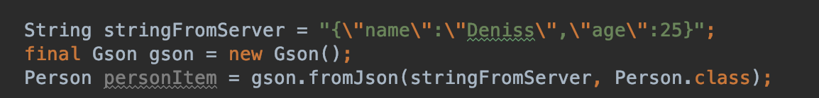
Map string from server to local object

Slide 26
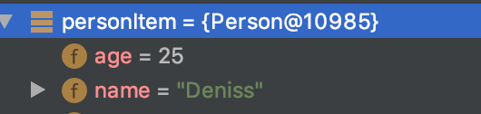
Object created, No need to parse each property

Slide 27
Gson (JSON parsing)
Map your object to JSON representation
https://github.com/google/gson

Slide 28
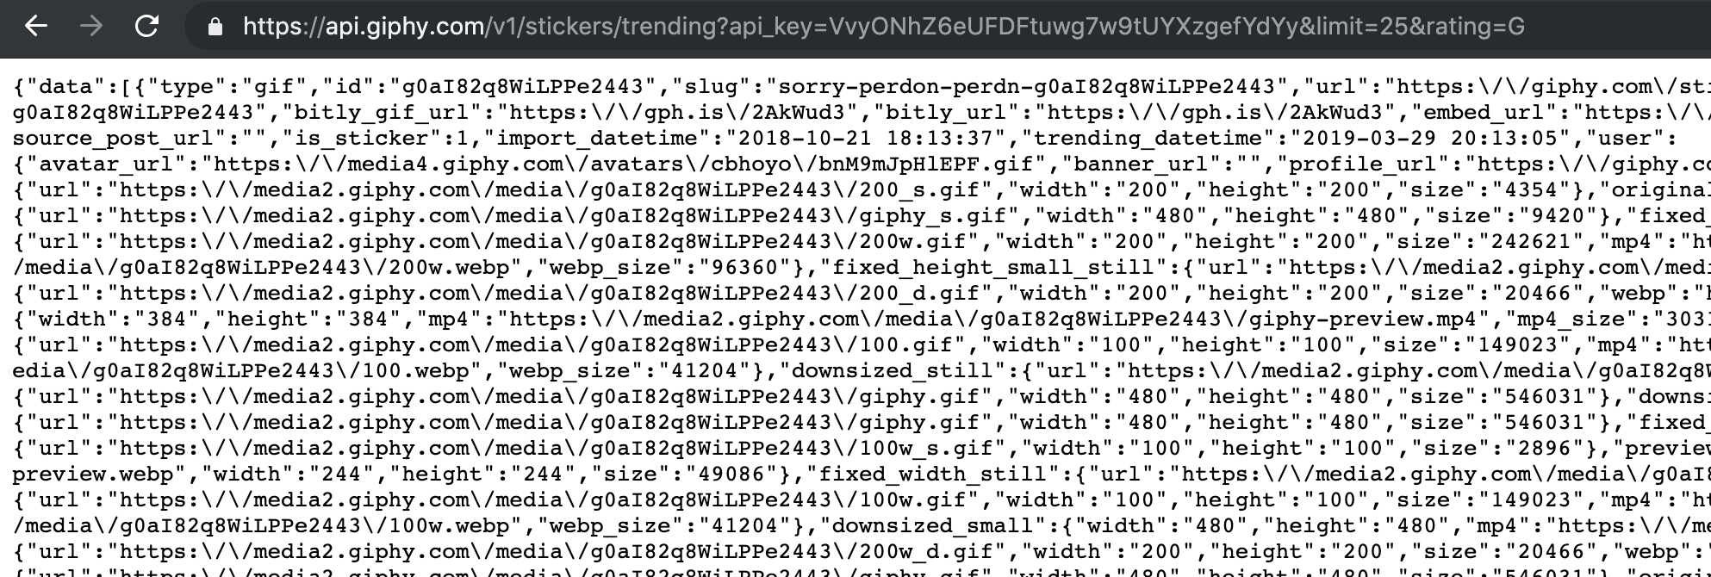
You have a data that you want in your app

Slide 29
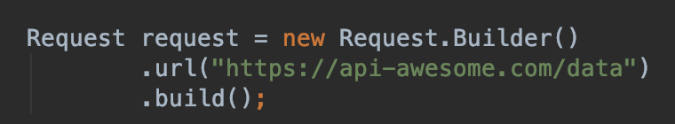
1- Create request with url to data

Slide 30
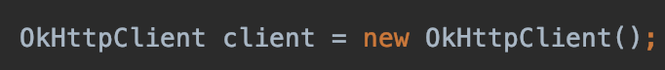
2 – Create a client that would do all the work

Slide 31
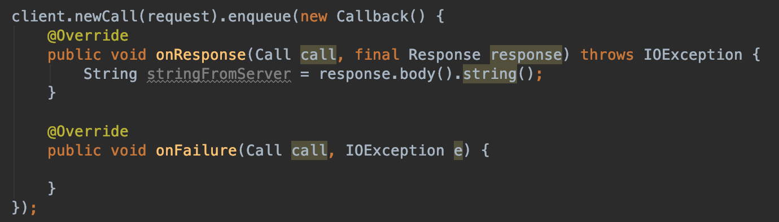
3 – pass request to client and wait for client to download

Slide 32
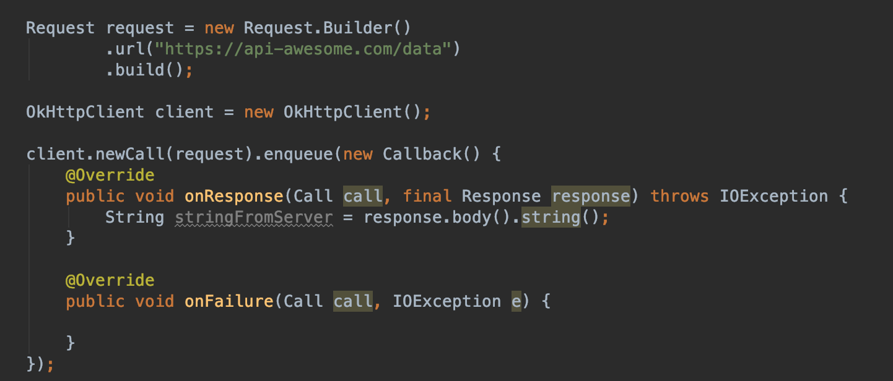
Summary

Slide 33
OkHttp (networking)
OkHttp is a third-party library developed by Square for sending and receive HTTP-based network requests.
http://square.github.io/okhttp/

Slide 34
Retorift (networking)
Retrofit is a type-safe REST client for Android, Java and Kotlin developed by Square. The library provides a powerful framework for authenticating and interacting with APIs and sending network requests with OkHttp.
http://square.github.io/retrofit/

Slide 35
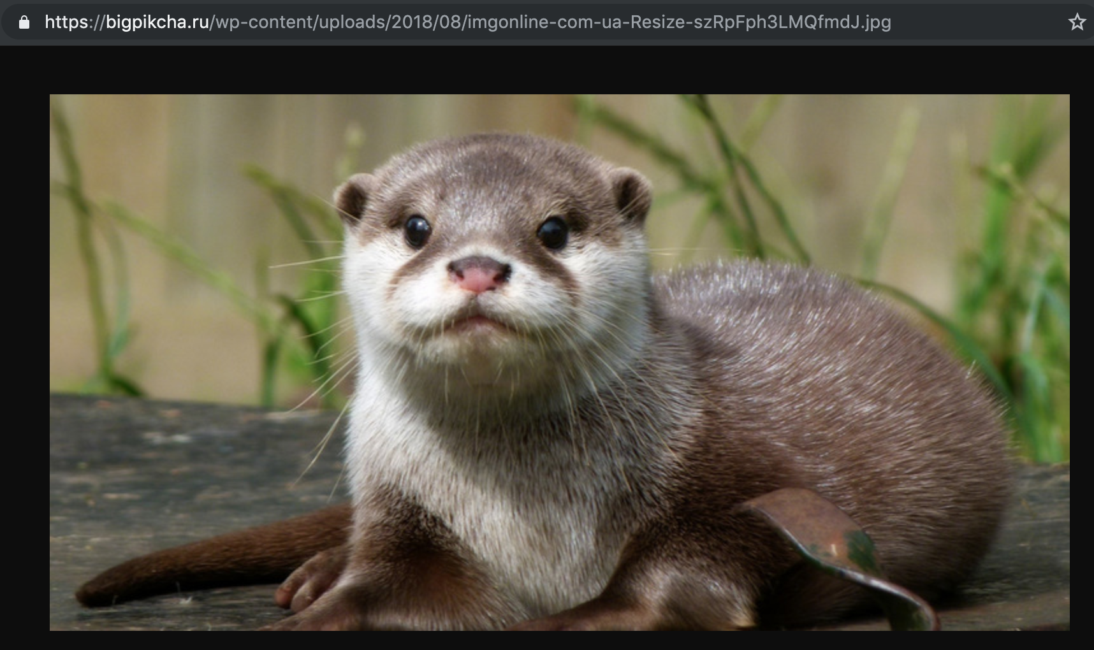
You have an image that is available via some url

Slide 36
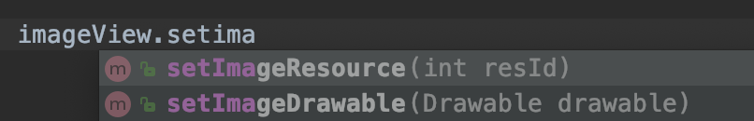
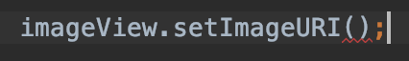
There is no method for that
Only local images

Slide 37
You could use picaso/glide to handle that

Slide 38
GlIde (Async Imaged download)
Glide is an Image Loader Library for Android developed by bumptech and is a library that is recommended by Google. It has been used in many Google open source projects including Google I/O 2014 official application. It provides animated GIF support and handles image loading/caching.
https://github.com/bumptech/glide

Slide 39
Picaso (Async Imaged download)
Images add much-needed context and visual flair to Android applications. Picasso allows for hassle-free image loading in your application—often in one line of code!
http://square.github.io/picasso/

Slide 40
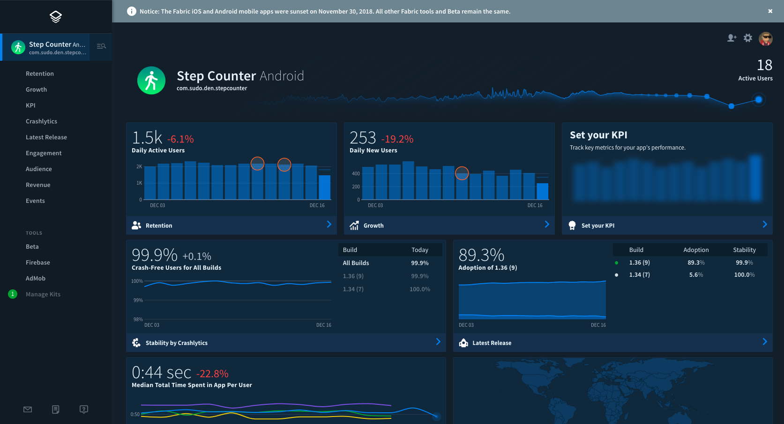
Fabric (analytics)
https://fabric.io/home

Slide 41
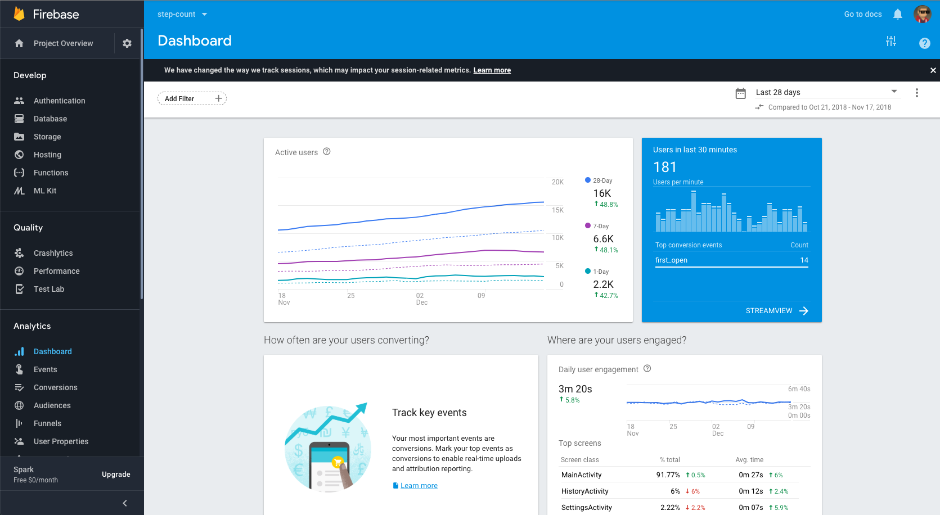
Firebase (Analytics)
https://firebase.google.com

Slide 42
How to get library to your project
1) Use gradle to download on demand
+ easy to get
+ easy to update
cant make changes
may become unavailable at any time
2) Add as module
+ project would always compile
+ can make changes to library (if its come open source)
not so easy to update

Slide 43
Wiki of libraries
https://guides.codepath.com/android https://guides.codepath.com/android/must-have-libraries

Slide 44
TODO:
Open MainActivity on Lesson4 and follow the steps ☺

Slide 45
Changes in lectures
22.04.2019 (No Lecture) -> Move to the next week
06.05.2019 (No lecture) -> Move to the next week

